Slide 1

Expectation Setting Overview (Day-1)
Subject: Database Management System
Subject Code:BCS403
Semester : 4
Course Instructors: Prof.Komala Devi,Prof.Abdul, Prof.Janhavi
Department of Information Science and Engineering,
CMRIT – Bangalore.

Slide 2

Agenda
Day-01
Introduction
Student perspective
Introduction to subject
Why subject is important
Real World Applications
Course Objectives
Pre-requisites
Course Outcomes
CO-PO mapping
Quiz
Day-02
Textbooks and Reference books
Lesson Plan
Assessment Plan
Expected classroom behavior
Some useful links

Slide 3
Introduction
janhavi.gp@cmrit.ac.in/9665877207
Meet: 2-4 pm
Mobile: 8am-4pm
Whatsapp: 8 am to 8 pm

Slide 4

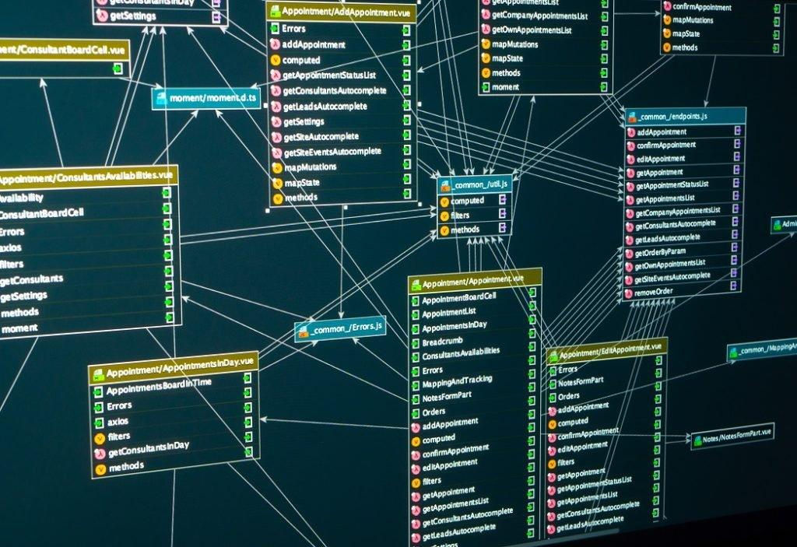
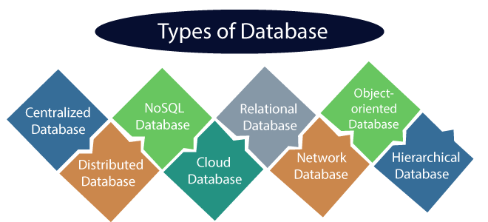
Students perspective
Students introducing themselves
Expectations – Questions

Slide 5
Introduction to DBMS
Data, Information, Tabulation, Access (Add, Delete, Update)
Data?
Information?
Tabulation?
Access?

Slide 6
What Is Database Management System?
A database management system (DBMS) is a software tool that helps users create, manage, and access data in a database.
It's like an electronic filing cabinet that stores and organizes data in a structured way.

Slide 7
Why the Database Management is important?
Database management is crucial because it allows organizations to effectively store, organize, access, and manage large volumes of data consistently, ensuring data integrity, security, and facilitating informed decision making by centralizing data and minimizing redundancy across systems.
Key reasons why database management is important:
Data Security:
Data Integrity:
Centralized Data Storage:
Efficient Data Access:
Data Sharing:
Scalability:

Slide 8

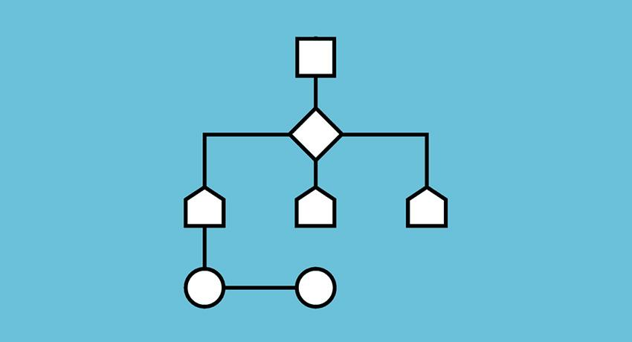
Pre-requisites
Object Oriented Concepts.
Set Theory Operations.
Basic Data Types.
*

Slide 9
Real Time Applications of DBMS
Company Database
Bank Database
University/College/ - Student Database
Govt. Databases
Passenger (Train/Bus/etc.,)
Customer Database(Sales/Product/etc.,)

Slide 10
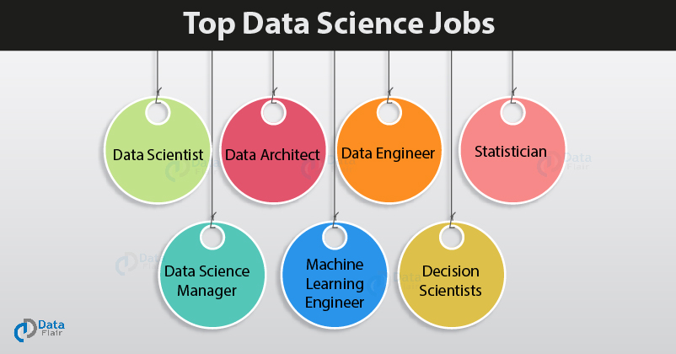
Scope-Job Perspective
Entry-Level Roles
Junior DBA
SQL Developer
Database Support Engineer
Data Analyst (SQL-based)
Backend Developer (Fresher)
Database Administrator
*

Slide 11
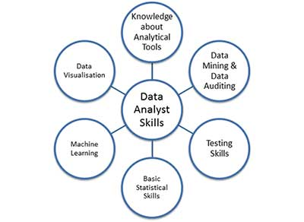
Scope-Higher Studies Perspective
Masters in India/Abraod
Online Degree programs
MOOC
Florida Institute of Technology
Carnegie Mellon University
Auburn University
Kennesaw State University
Boston University
Stevens Institute of Technology
DePaul University
University of Southern California
*

Slide 12
Course Objectives
To Provide a strong foundation in database concepts, technology, and practice.
To Practice SQL programming through a variety of database problems.
To Understand the relational database design principles.
To Demonstrate the use of concurrency and transactions in database.
To Design and build database applications for real world problems.
To become familiar with database storage structures and access techniques.

Slide 13
Course Outcomes
Course Outcomes
By the end of this course, students will be able to
Describe the basic elements of a relational database management system
Design entity relationship for the given scenario.
Apply various Structured Query Language (SQL) statements for database manipulation.
Analyse various normalization forms for the given application.
Develop database applications for the given real world problem.
Understand the concepts related to NoSQL databases.

Slide 14
CO-PO mapping
CO-PO and CO-PSO Mapping
Course Outcomes |  | Blooms Level | Modules covered | PO1 | PO2 | PO3 | PO4 | PO5 | PO6 | PO7 | PO8 | PO9 | PO10 | PO11 | PO12 | PSO1 | PSO2 | PSO3 | PSO4
CO1 | Describe the basic elements of a relational database management system | L1 | 1,2 | 3 | 2 | 2 | 2 | - | - | - | - | - | - | - | - | 2 | - | - | -
CO2 | Design entity relationship for the given scenario. | L2 | 2,3 | 3 | 3 | 3 | 2 | - | - | - | - | - | - | - | - | 2 | - | -
CO3 | Apply various Structured Query Language (SQL) statements for database manipulation. | L3 | 4 | 3 | 3 | 3 | 3 | 3 | - | - | - | - | - | - | - | 2 | - | - | 3
CO4 | Analyse various normalization forms for the given application. | L3 | 5 | 3 | 3 | 3 | 3 | - | - | - | - | - | - | - | - | 2 | - | - | -
CO5 | Develop database applications for the given real world problem. | L3 | 4 | 3 | 3 | 3 | 3 | 3 | - | - | - | 2 | - | - | - | 2 | - | - | 3
CO6 | Understand the concepts related to NoSQL databases. | L3 | 5 | 3 | 2 | 3 | 2 | 2 | - | - | - | - | - | - | - | 2 | - | -- | -

Slide 15
Quiz on COs/expectation setting
What is the second CO?
Differentiate between Course Objective and Course Outcome?
Differentiate between Data, Information, Knowledge, and Intelligence?
What is the significance of this course to ISE students?

Slide 16
Text books
Fundamentals of Database Systems, Ramez Elmasri and Shamkant B. Navathe, 7th Edition, 2017, Pearson.
2. Database management systems, Ramakrishnan, and Gehrke, 3rd Edition, 2014, McGraw Hill

Slide 17
Lesson Plan-Modules
Module – 1
Introduction to Databases: Introduction, Characteristics of database approach, Advantages of using the DBMS approach, History of database applications.
Overview of Database Languages and Architectures: Data Models, Schemas, and Instances.Three schema architecture and data independence, database languages, and interfaces, The Database System environment.
Conceptual Data Modelling using Entities and Relationships: Entity types, Entity sets and structural constraints, Weak entity types, ER diagrams, Specialization and Generalization.

Slide 18
Lesson Plan-Module 2
Module – 2
Relational Model: Relational Model Concepts, Relational Model Constraints and relational database schemas,Update operations, transactions, and dealing with constraint violations.
Relational Algebra: Unary and Binary relational operations, additional relational operations (aggregate, grouping, etc.) Examples of Queries in relational algebra.
Mapping Conceptual Design into a Logical Design: Relational Database Design using ER-to-Relational mapping.

Slide 19
Lesson Plan-Module 3
Module – 3
Normalization: Database Design Theory – Introduction to Normalization using Functional and Multivalued Dependencies: Informal design guidelines for relation schema.Functional Dependencies, Normal Forms based on Primary Keys, Second and Third Normal Forms, Boyce-Codd Normal Form, Multivalued Dependency and Fourth Normal Form, Join Dependencies and Fifth Normal Form.
SQL: SQL data definition and data types, Schema change statements in SQL, specifying constraints in SQL, retrieval queries in SQL, INSERT, DELETE, and UPDATE statements in SQL, Additional features of SQL

Slide 20
Lesson Plan-Module 4
Module – 4
SQL: Advanced Queries: More complex SQL retrieval queries, Specifying constraints as assertions and action triggers, Views in SQL.
Transaction Processing: Introduction to Transaction Processing, Transaction and System concepts, Desirable properties of Transactions, Characterizing schedules based on recoverability, Characterizing schedules based on Serializability, Transaction support in SQL.

Slide 21
Lesson Plan-Module 5
Module – 5
Concurrency Control in Databases: Two-phase locking techniques for Concurrency control, Concurrency control based on Timestamp ordering, Multiversion Concurrency control techniques, Validation Concurrency control techniques, Granularity of Data items and Multiple Granularity Locking.
NOSQL Databases and Big Data Storage Systems: Introduction to NOSQL Systems, The CAP Theorem, Document-Based NOSQL Systems and MongoDB, NOSQL Key-Value Stores, Column-Based or Wide Column NOSQL Systems, NOSQL Graph Databases and Neo4j

Slide 22
Assessment plan
IAT # | SYLLABUS
IAT-1 | CLASS 01-34
IAT-2 | CLASS #35-50
Evaluation method | Weightage
IAT (Avg of three) | 15
Assignment/quiz | 10
Practical | 25
Total | 50 (CIE) +50(SEE)

Slide 23


Expected classroom behaviour
Active and Interactive Learning
Quizzes
Attendance: 85%
Hand written assignments (no plagiarism etc),
sticking to deadlines for submissions
no disruption
strict action against abusers

Slide 24
Some useful links
https://www.cs.uregina.ca/Links/class-info/215/erd/#:~:text=Data%20modeling%20is%20a%20technique,data%20requirements%20for%20a%20database
https://www.geeksforgeeks.org/generalization-specialization-and-aggregation-in-er-model/
https://www.guru99.com/relational-data-model-dbms.html
https://www.tutorialspoint.com/dbms/relational_algebra.htm

Slide 25
Thank You

